Slide 1
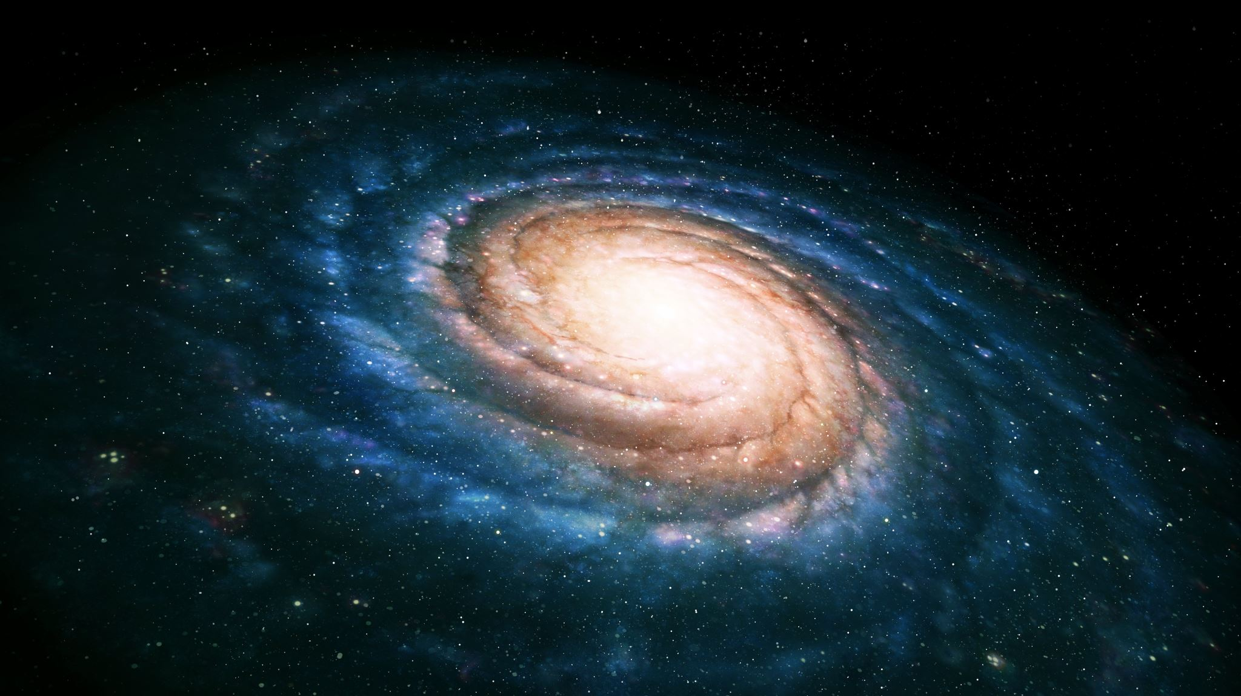
The Shapiro Delay

Slide 2
Background
Neutron stars
Pulsars
Times of Arrival (TOA)
Line of sight (LOS)
Romer Delay
Einstein Delay

Slide 3
Neutron Stars
  Compact stars
  Masses similar to our Sun
  Spin rapidly
  Originate from binary systems
  Emits beams of electromagnetic radiation
Pulsars
  Neutron stars that have their magnetic poles aligned with the Earth
Line of Sight (LOS)
  Axis connecting pulsar and Earth

Slide 4
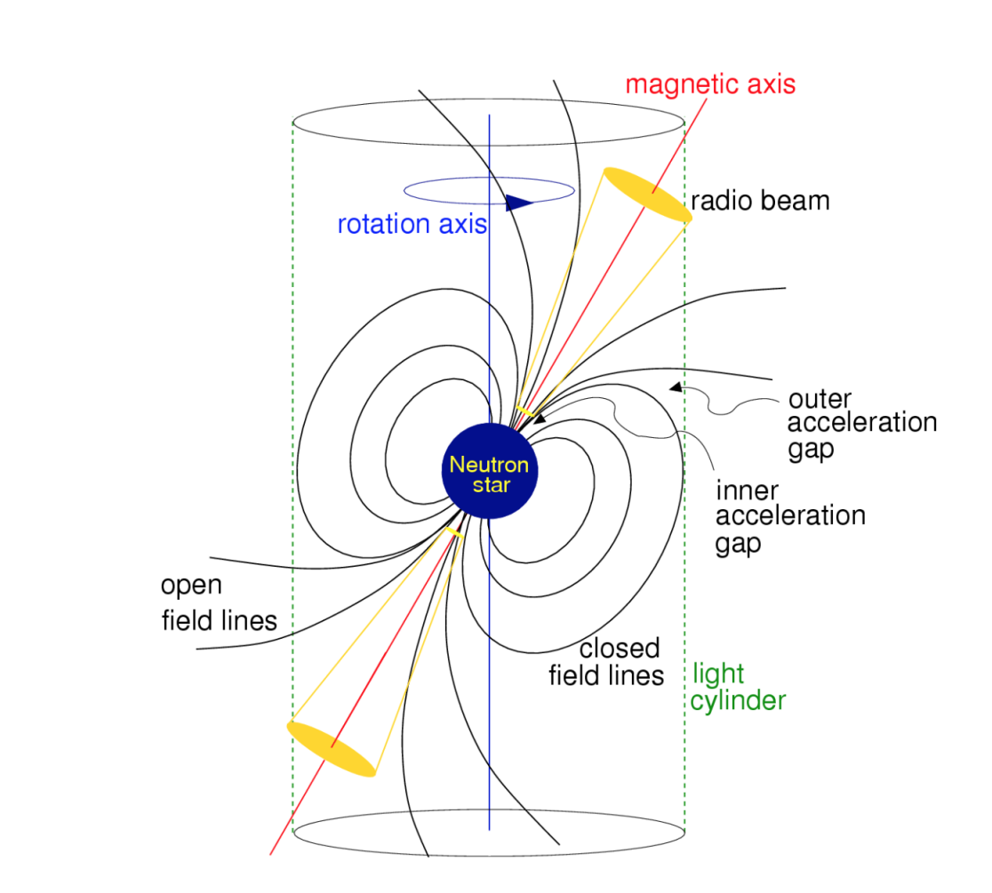

Slide 5
Pulsar Timing
  The process of creating a model that accounts for every single pulse from a pulsar over long periods of time
Times of Arrival (TOAs)
  The measurement from pulsar timing
  Absolute Time Instant
  Timing Residuals – difference between the measured TOA and the predicted value
Pulsar Timing Arrays
  NANOGrav (North American Nanohertz Observatory for Gravitational Waves)
    Uses data from the Arecibo and Green Bank radio telescopes
  EPTA (European Pulsar Timing Array)
    Uses data from 4 largest radio telescopes in Europe:
      Lovell Telescope
      Westerbork Synthesis Radio Telescope
      Effelsberg Telescope
      Nancay Radio Telescope
Notes:
Owing both to pulsars’ extremely stable spin periods and also to the fact that our models track integer numbers of pulses, pulsar timing has yielded some of the most precise measurements in astrophysics.
The description of pulsars as “clock-like” is perhaps overused — though for a good reason.
The extremely slow spin-down of MSPs, for example, means that our timing measurements rival the precision of atomic clocks

Slide 6
Römer delay
  Classical light travel time across Earth’s orbit
Einstein delay
  Accounts for the effects of gravitational redshift

Slide 7
What is the Shapiro Delay?
Named after Irwin Shapiro, who wrote a paper predicting this phenomenon in 1964, titled: The Fourth Test of General Relativity (REF1)
The Shapiro delay itself cannot be observed directly, whereas it is possible to observe some changes in the Shapiro delay. (REF2)
“Because, according to the general theory, the speed of a light wave depends on the strength of the gravitational potential along its path, these time delays should thereby be increased by almost 2x10⁻⁴ sec when the radar pulses pass near the Sun” – fourth test of general relativity, Irwin Shapiro (REF1)
Notes:
REF1 - Fourth Test of General Relativity - https://doi.org/10.1103/PhysRevLett.13.789, I. I. Shapiro, Fourth Test of General Relativity, Phys. Rev.
Lett. 13, 789 (1964).
REF2 – Sakai, Satoru (2011) The effect of Shapiro delay on pulsar timing PhD thesis

Slide 8
Why do we measure it?
It is of great interest to obtain more neutron star mass measurements, in order to probe a wider parameter space of the EOS and to better understand the true distribution of neutron star masses.
Can yield precise mass for both a millisecond pulsar and its companion
Determining how much effect this change in Shapiro delay will have on pulsar timing allows for the introduction of another correction term, allowing for the possibility of reducing timing noise, as well as improving the chances for detecting gravitational waves.

Slide 9
When is it important?
When the pulsar’s binary companion approaches the LOS
When the inclination is close to 90º

Slide 10
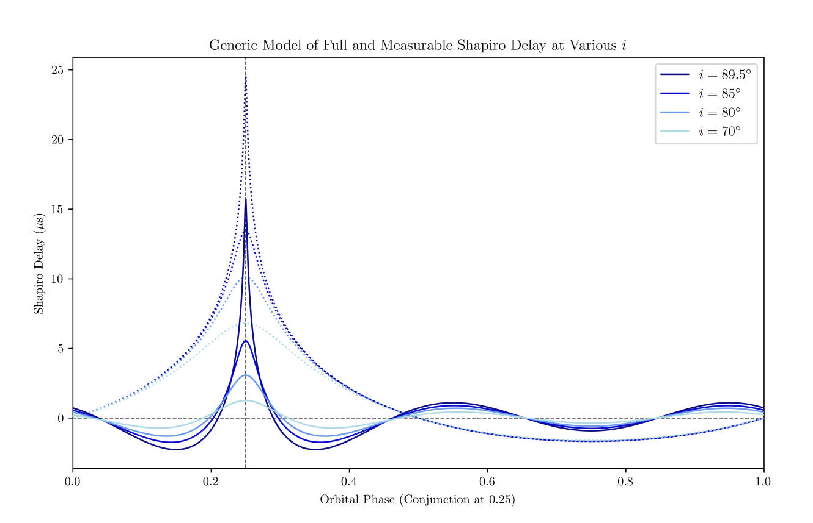

Slide 11
How do we measure it?
The Shapiro delay is a term that cannot be directly observed, but is inferred from movement of stars within the globular cluster. Since the stars move around the globular cluster, this results in the change in Shapiro delay over time – the Shapiro noise – which is an observable quantity.
The post-Keplerian parameters r (Shapiro range) and s (Shapiro shape) are directly measurable and via these the Shapiro delay can be found

Slide 12

Shapiro Delay Equation 020202
$∆_{S}^{(LO)}=−2r\ln{Λ_{u}}$
$Λ_{u}=1 −e_{T}\cos{u} −s[sinω\left(\cos{u}− e_{T}\right)+(1 −e_{T}^{2})^{\frac{1}{2}}\cos{ω}\sin{u}]$
PK parameters:
  $r$ – range of the Shapiro delay
  $s$ – shape of the Shapiro delay
  $s=\sin{i}$ (Shapiro shape = the sine of the orbital inclination)
  Range of the Shapiro delay is linked to the mass of the companion
  $r=Gm_{B}/c^{3}$
Notes:
This basic version of the equation ignores the lens and retardation correction terms
Strong-Field Gravity Tests with the Double Pulsar, M. Kramer et al.
Phys. Rev. X 11, 041050 – Published 13 December 2021, DOI:https://doi.org/10.1103/PhysRevX.11.041050

Slide 13

Shapiro Delay Equation
$Δ_{S⊙}=\frac{2GM_{⊙}}{c^{3}}\ln{[|r_{⊙}|}(1+\cos{θ})]$
Complete Shapiro delay equation:
  $t_{Sh}=\frac{2GM}{c^{3}}\left(\left|\frac{\sqrt{D_{L}^{2}+a^{2}}}{a}+\frac{D_{L}}{a}\right|+κ\ln\left|\frac{\sqrt{a^{2}+D_{LS}^{2}}}{a}+κ\frac{D_{LS}}{a}\right|\right)$
  Where $κ=\frac{D_{LS}}{|D_{LS}|}$
Notes:
First equation here considers only the Sun

Slide 14
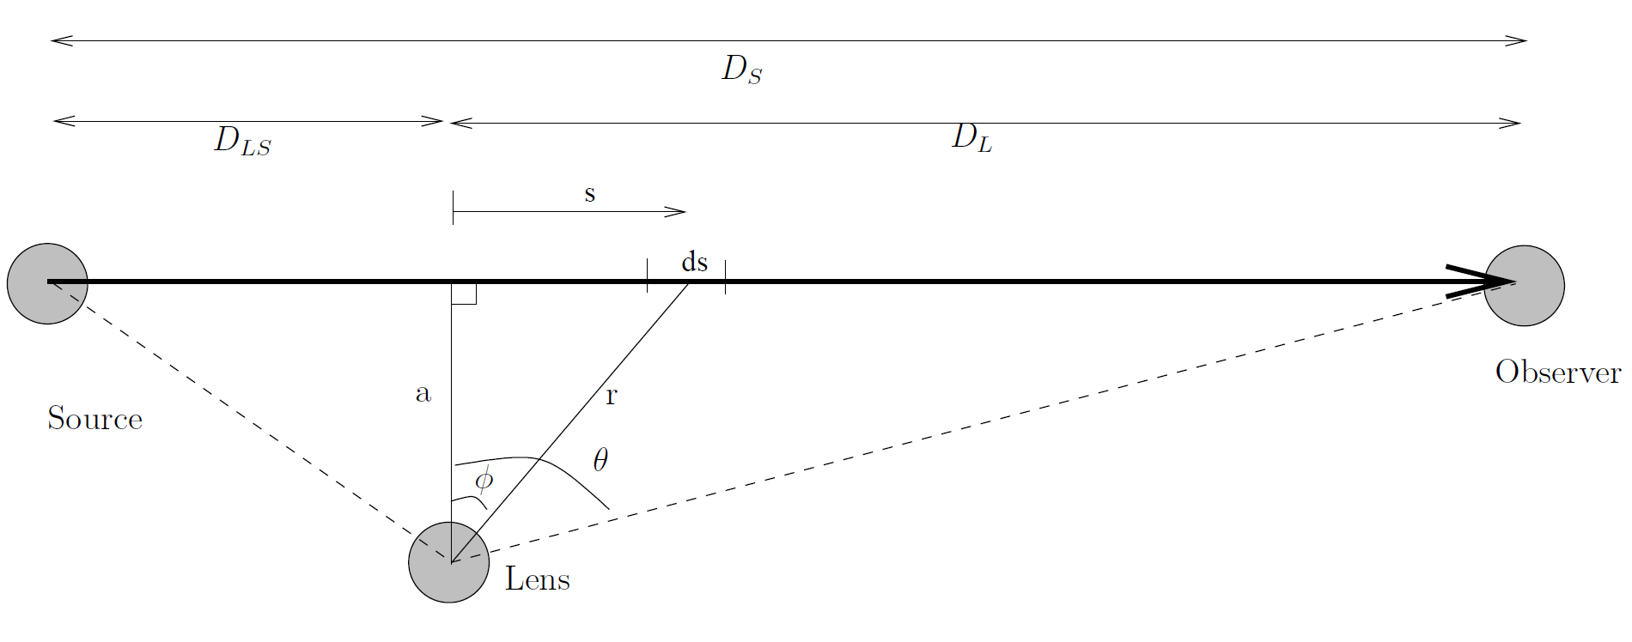
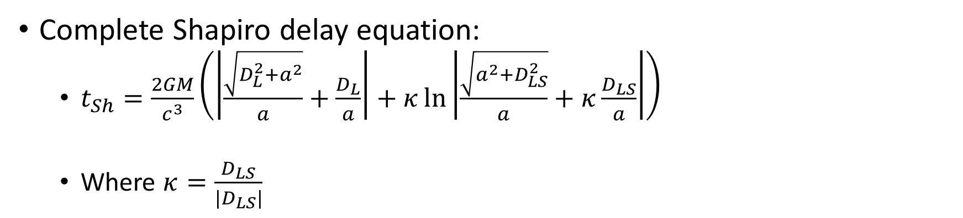
Complete Shapiro delay equation:
  $t_{Sh}=\frac{2GM}{c^{3}}\left(\left|\frac{\sqrt{D_{L}^{2}+a^{2}}}{a}+\frac{D_{L}}{a}\right|+κ\ln\left|\frac{\sqrt{a^{2}+D_{LS}^{2}}}{a}+κ\frac{D_{LS}}{a}\right|\right)$
  Where $κ=\frac{D_{LS}}{|D_{LS}|}$

Slide 15
PSR J0737-3039A/B
Unique due to the fact that both neutron stars in the binary system are detectable as radio pulsars.
Notes:
This double pulsar binary gives great strong field tests for general relativity

Slide 16

Strong field gravity tests
One can test s as part of a $\dot{ω}−γ_{E}−s$ test, which leads to:
$\frac{s^{obs}}{s^{GR}}=1.000 09(18)$
Meaning a 4 x 10⁻⁴ (95% C.L.) test in agreement with GR
Notes:
Strong-Field Gravity Tests with the Double Pulsar, M. Kramer et al.
Phys. Rev. X 11, 041050 – Published 13 December 2021, DOI:https://doi.org/10.1103/PhysRevX.11.041050
Double Pulsar PSR J0737-3039A/B

Slide 17

Strong field gravity tests
A test of the Shapiro range $r$ directly probes the interaction between a strongly self-gravitating NS and a photon.
Paper shows that:
$\frac{r^{obs}}{r^{GR}}=1.0016\left(34\right)$
leading to a 7 x 10⁻³ (95% C.L.) test of $r$ in agreement with GR
Notes:
Strong-Field Gravity Tests with the Double Pulsar, M. Kramer et al.
Phys. Rev. X 11, 041050 – Published 13 December 2021, DOI:https://doi.org/10.1103/PhysRevX.11.041050
Double Pulsar PSR J0737-3039A/B

Slide 18

PSR J0740+6620
Spins at approximately 346Hz as it orbits with its binary companion
Being in a binary at a favourable inclination for measurement of the Shapiro delay allows the mass of this source to be measured independently via radio timing.
Highest mass neutron star (Cromartie et al (2020))
High-mass neutron stars (with the highest central densities) are particularly powerful in terms of their potential to constrain the dense matter EOS.
The radio observations of the Shapiro delay by NANOGrav and CHIME/Pulsar (Fonseca et al 2021a) lead to the marginal 68% credible interval of M=2.08 ± 0.07 $⊙$
Notes:
Spin shows it’s a millisecond pulsar
Highest mass neutron star measured to date

Slide 19
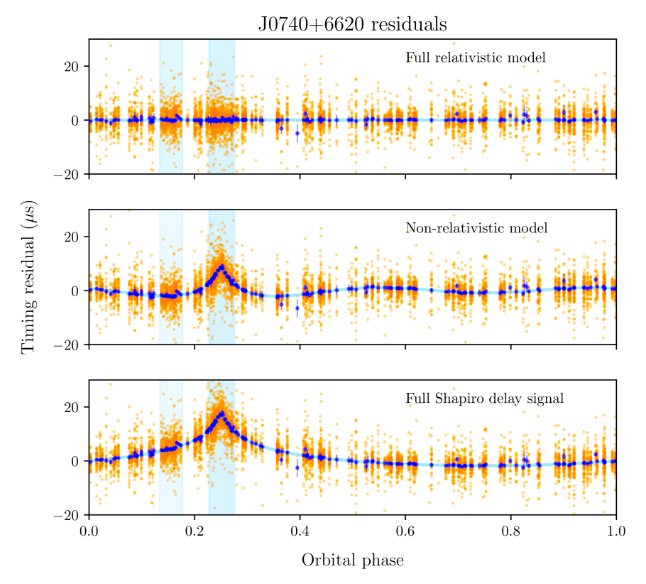
Notes:
Spin shows it’s a millisecond pulsar
Highest mass neutron star measured to date

Slide 20
Summary
Shapiro delay constrains parameters precisely to achieve masses of pulsars and rule out incorrect equations of state.
Acts as an extra backbone to General Relativity

